Slide 1
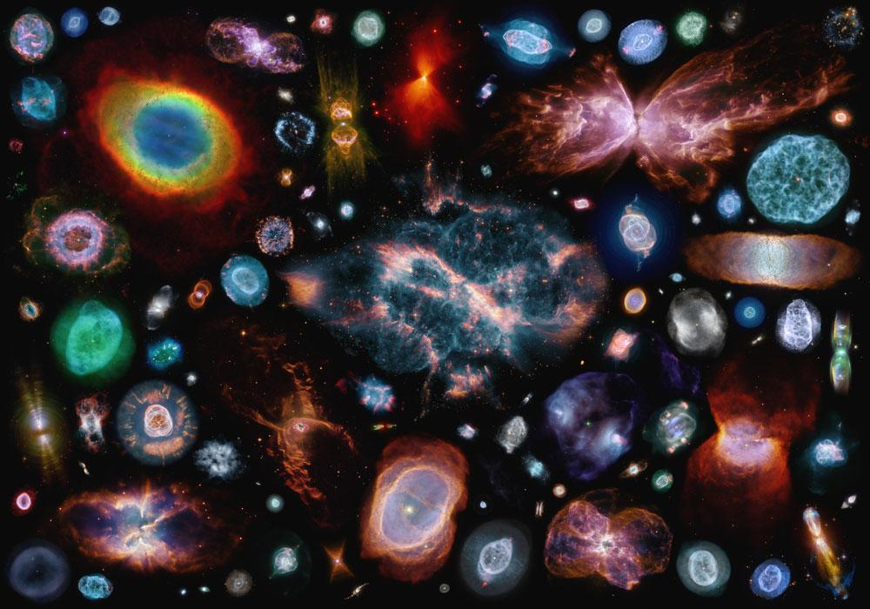
Transfer Learning for Planetary Nebulae Classification
Reproducibility Study *
Joseph Hadidjojo: CV, ML classes
Tung Pham: ML, CV class
Arman Muratbayev: ML classes, current CV student

Slide 2
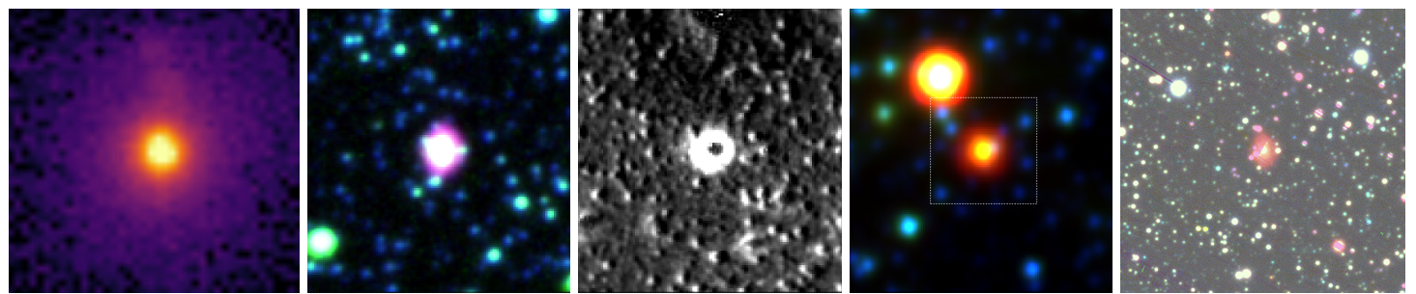
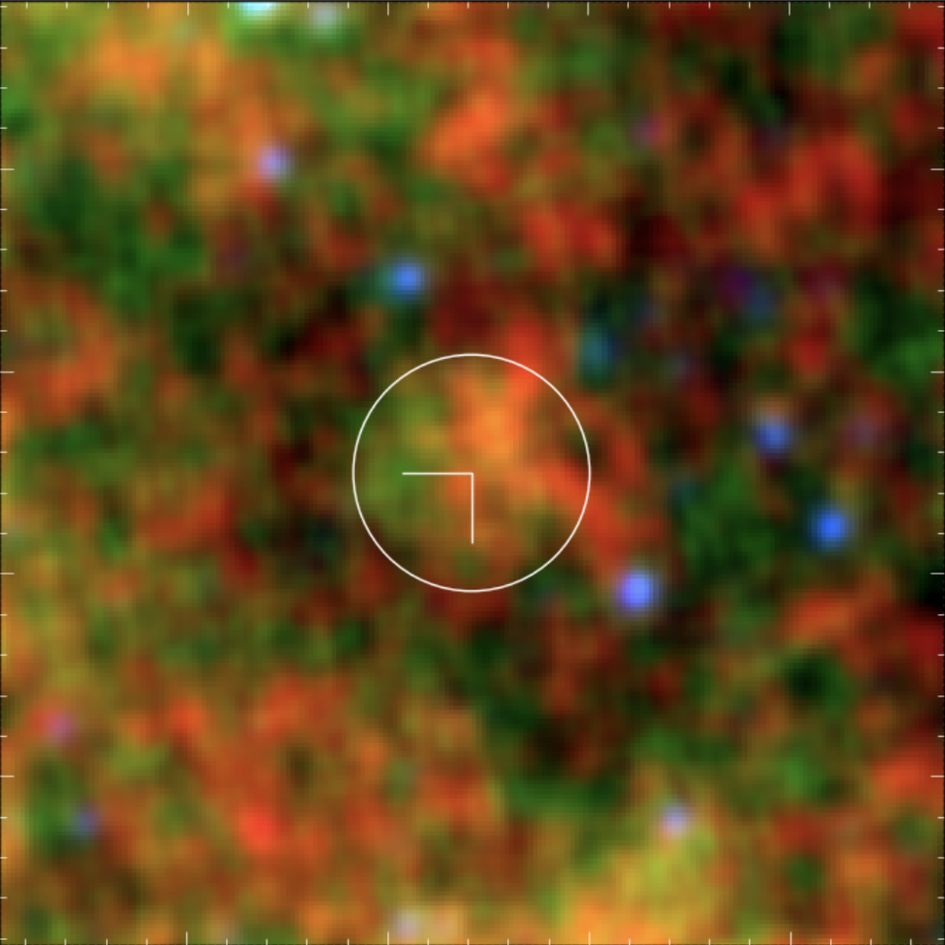
Planetary Nebulae (PNe) Classification
Goal: Given Deep Space Images of Elliptical Objects, classify True PNe or Rejected PNe
Input: 256x256x3 (RGB) Images as Tensor of float64
Output: Binary Classification (True or Rejected)

Slide 3
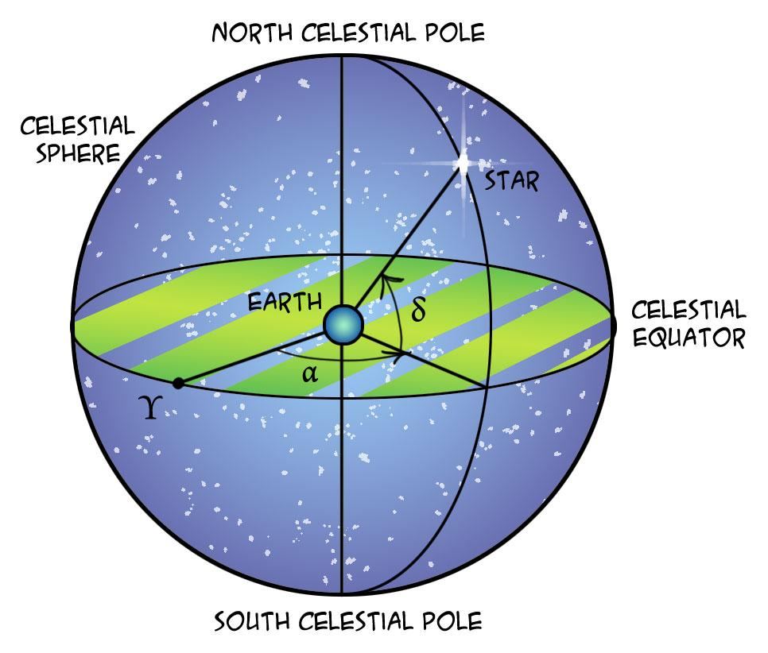
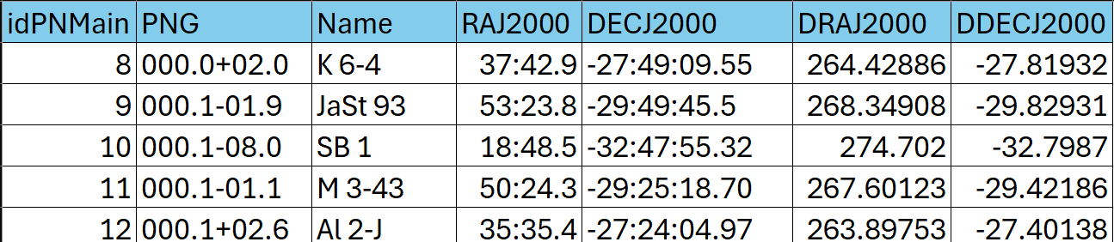
Data and Evaluation
HASH-PN dataset (Parker, et. al., 2016)
Over 30,000 Images, 5426 Labeled
8/1/1 split of train/val/test
Employ strict partitioning to prevent leakage (based on coordinates)
Notes:
Imagenet contain “everyday objects”, not really astronomy-related images
To avoid data leakage we have a full table of all 30000 thousand images with distinct celestial coordinates

Slide 4
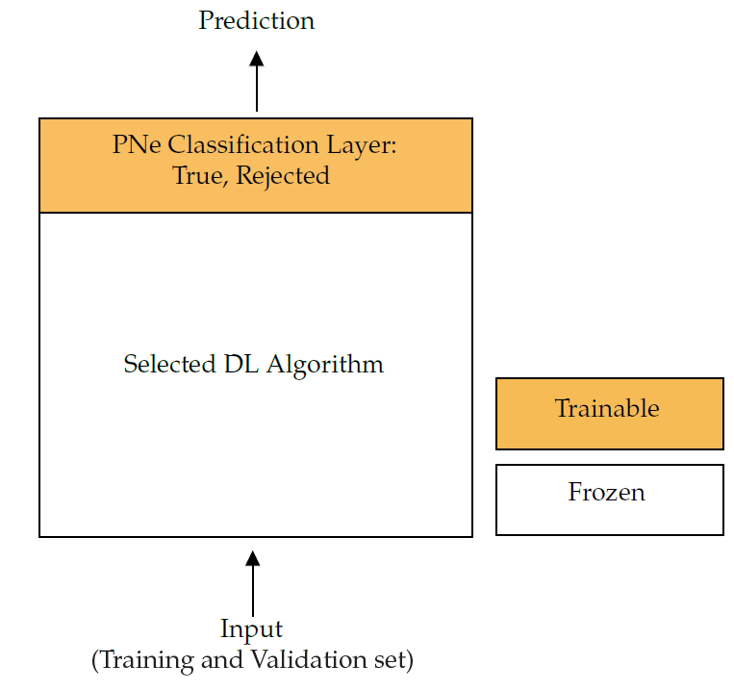
Methods
Reproducibility Study*
Candidate Methods:
Baseline pre-trained models on ImageNet1k
InceptionResNetV2
DenseNet201
ResNet50
Perform Linear Probing on the best performing baseline model*
Perform (possibly Full) Fine-Tuning on the best performing baseline model*
Preliminary Hypothesis:
Fine-Tuning will outperform Baseline and Linear Probing due to large Domain-Shift
*Extensions to Original Paper
Notes:
Mention how Original paper did not do any LP or FT - hence our work will be an extension to this.

Slide 5
Challenges
No Public code availability (but simple & straightforward methodology)
Action: Write preliminary code and identify possible blockers/deviations from source.
Attempted: Contact Authors
Bulk Dataset Access (No API) and cumbersome Interface
Action: Better familiarization of Interface and initial scrapping attempt.
Notes:
No code for data preprocessing b/c not all of the images are of the same size so we’ll have to do some data preprocessing to
No code for data scrapping or collection
Mentioned about PLAN-STARSS
If we go with PLAN-STARSS, no label -> have to find a way to map the label from HASHDB over.

Slide 6
Questions?

